Slide 1
Report : Lidar Assisted Controller
Date: 21/10/25
Supervisor: prof. David Schlipf
Group members: Midhun Kanichattu Venu,Hesham Mahmoud

Slide 2
Overview
This project presents the implementation of a Lidar-Assisted Control (LAC) strategy for wind turbine optimization. The controller integrates feedforward (FFP), lidar-based (LDP), and feedback (ROSCO) modules through a Wrapper interface in OpenFAST. The objective is to reduce cost and improve stability by tuning the buffer time (T_buffer) parameter.
Hesham Mahmoud 770604

Slide 3
Main Objectives
Replace direct ROSCO linkage with Wrapper.DLL/IN interface.
Connect Wrapper to FFP and LDP dynamic libraries.
Use ROSCO_FBFF.IN file with LAC enabled.
Optimize T_buffer using brute-force simulation to minimize cost.
Wind Input
LDP
FFP
Wrapper.DLL
ROSCO
Turbine
Hesham Mahmoud 770604

Slide 4
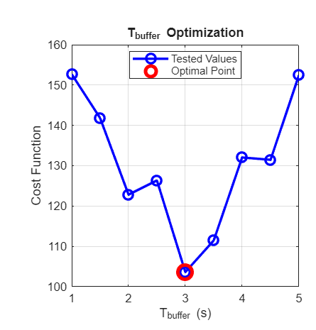
Cost Function vs T_buffer
The cost function was evaluated for several buffer times ranging from 1 to 5 seconds. The optimal configuration was found at T_buffer = 3.0 s, achieving the lowest cost of 103.6.
Hesham Mahmoud 770604

Slide 5
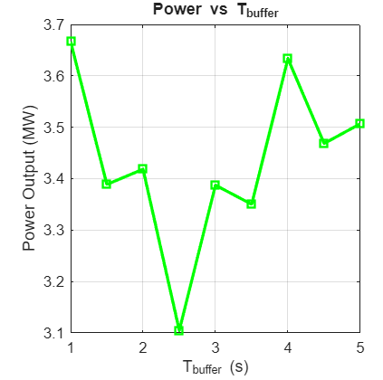
Power vs T_buffer
Power output varies slightly with the buffer time, showing a stable mean around 3.4–3.6 MW. The optimized T_buffer maintains high power capture without excessive oscillation.
Midhun Kanichattu Venu 770588
Hesham Mahmoud 770604

Slide 6
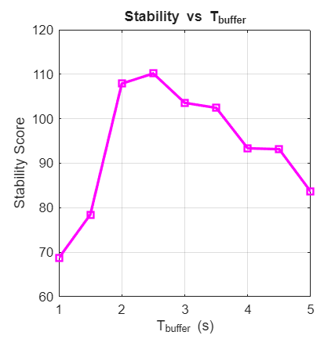
Stability vs T_buffer
The stability score improves between 2–3 seconds, confirming that a moderate buffer provides better damping and smoother turbine response.
Hesham Mahmoud 770604

Slide 7
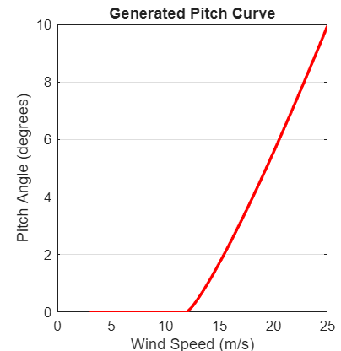
Generated Pitch Curve
The pitch curve was generated for 45 wind speeds ranging from 3.0 to 25.0 m/s. The pitch angle increases progressively above 12 m/s, ensuring aerodynamic load reduction while maintaining efficiency.
Hesham Mahmoud 770604

Slide 8
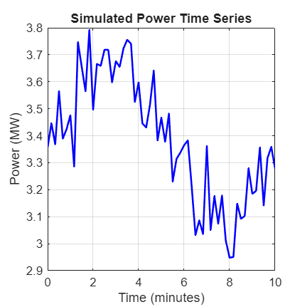
Simulated Power Time Series
The power output remains generally stable over the 10-minute simulation. Small variations indicate the dynamic response of the optimized control system. Average output remains around 3.39 MW.
Hesham Mahmoud 770604

Slide 9
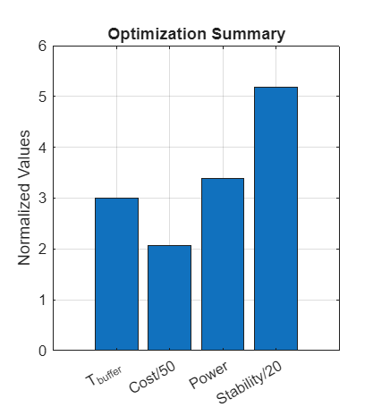
Optimization Summary
The normalized comparison shows that T_buffer = 3 s provides the best trade-off between cost, power, and stability. All tested configurations confirmed the robustness of the Wrapper-based control approach.
Hesham Mahmoud 770604

Slide 10
Conclusions
The Wrapper successfully integrates FFP, LDP, and ROSCO_FBFF with LAC enabled.
The optimized T_buffer = 3 s reduced total cost and improved system stability.
The control approach is validated for future steady-state and Lidar field implementation.
Hesham Mahmoud 770604

Slide 11
Bibliography – Lidar Assisted controller
Hansen, M. Aerodynamics of Wind Turbines, 3rd Ed., Routledge, 2015.
Ingram, G. Wind Turbine Blade Element Momentum Theory, 2011.
Bossanyi, E. Controller Design for Variable-Speed Wind Turbines, Wind Engineering, 2000
Hesham Mahmoud 770604

